Slide 1
Digital Health Information Access and Reproductive Health
Literacy Among Adolescent In
Bangladesg
Prepared By : Nasima Akter Nirjona
Supervisor :Dr. Shakhaoat Hossain
Department : Public Health and Information
Batch : 04(WMPH)
University : Jahangirnagar University

Slide 2
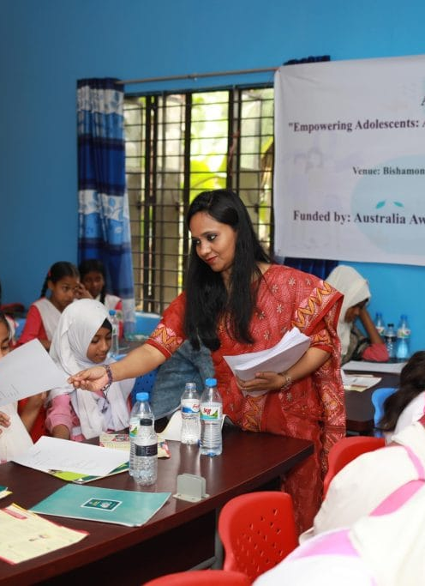
1. INTRODUCTION
2. OBJECTIVES
3. METHODS
4. EXPECTED OUTCOMES
5. LIMITATIONS
6. CONCLUSION
7. REFERENCES (TO BE UPDATED WITH RECENT LITERATURE0

Slide 3
Adolescents need accurate reproductive health information to make informed decisions and maintain healthy behaviors. However, many adolescents in Bangladesh have limited access to reliable information due to social and cultural barriers. This study aims to examine the association between access to reproductive health information and adolescents' knowledge, attitudes, and practices (KAP) in Bangladesh.
intriductionS

Slide 4
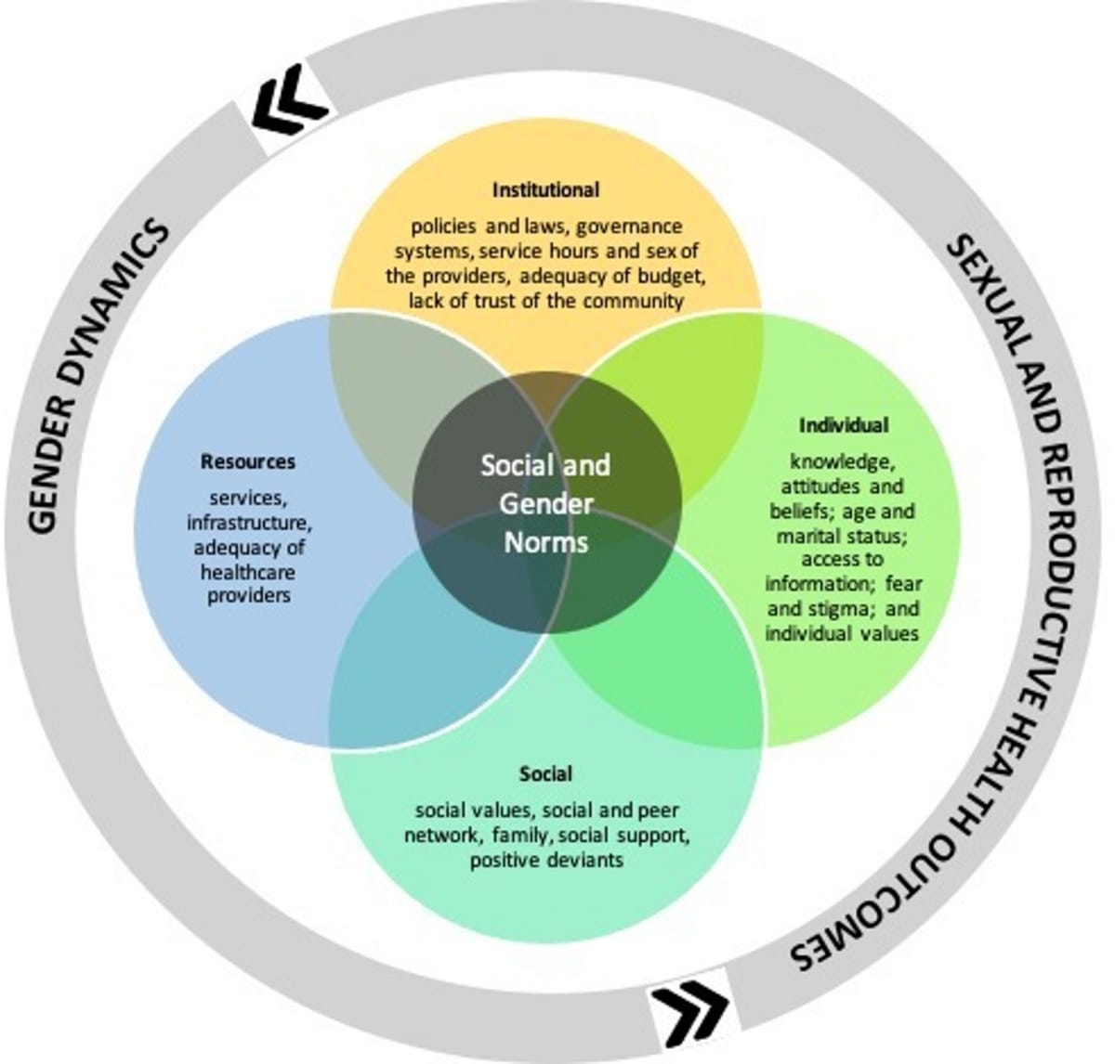
OBJECTIVES
General Objective
To assess the association between access to reproductive health information and knowledge, attitudes, and practices among adolescents in Bangladesh.

Slide 5
Specific Objectives
To identify the major sources of reproductive health information among adolescents.
To measure the level of reproductive health knowledge.
To assess adolescents' attitudes toward reproductive health issues.
To evaluate reproductive health-related practices.-
To determine socio-demographic and other factors associated with access to reproductive health information.

Slide 6
Methods
Study Design: Analytical cross-sectional study.Study
Population: Adolescents aged 10–19 years.
Study Area: Selected secondary schools, colleges, and communities in Bangladesh.
Sampling Method: Multistage random sampling.
Sample Size: To be calculated using a standard statistical formula based on the expected prevalence and desired precision.
Data Collection Tool: A structured questionnaire consisting of socio-demographic characteristics, access to reproductive health information, knowledge, attitude, and practice sections.
Data Collection Procedure: Data will be collected by trained data collectors after obtaining informed consent (and parental/guardian consent where applicable).

Slide 7
Data Analysis: Data will be entered, cleaned, and analyzed using statistical software. Descriptive statistics will summarize participant characteristics. Chi-square tests and logistic regression analyses will be used to examine associations. A p-value of less than 0.05 will be considered statistically significant.
Ethical Considerations: Ethical approval will be obtained from the appropriate institutional ethics committee. Participation will be voluntary, confidentiality will be maintained, and participants may withdraw at any time without consequence.

Slide 8

Expected Outcomes
The study is expected to identify the main sources of reproductive health information used by adolescents and evaluate their level of knowledge, attitudes, and practices. It is anticipated that adolescents with better access to reliable information will demonstrate higher knowledge levels and healthier attitudes and practices. The findings may support evidence-based adolescent reproductive health education and policy development in Bangladesh.

Slide 9
Limitations
The cross-sectional design will not establish cause-and-effect relationships.
Self-reported responses may be affected by recall bias or social desirability bias.
Sensitive topics may influence participants' willingness to provide completely accurate responses.-
Findings from selected study areas may not fully represent all adolescents in Bangladesh.

Slide 10
Conclusion
Access to accurate reproductive health information plays an important role in improving adolescents' knowledge, attitudes, and practices. This study will generate evidence on existing information sources, barriers, and associated factors among adolescents in Bangladesh. The findings may contribute to strengthening adolescent-friendly health education strategies and supporting future public health policies and interventions.

Slide 11
References
(to be updated with recent literature)
World Health Organization (WHO).
United Nations Population Fund (UNFPA).
United Nations Children's Fund (UNICEF).
Bangladesh Demographic and Health Survey (BDHS).
Recent peer-reviewed journal articles (published within the last 5 years) related to adolescent reproductive health and KAP studies.

Slide 12
Thank you

